Slide 1
Operating Systems (CPU Scheduling)
Presented By Sudeshna Kundu (Mondal)

Slide 2
CPU Scheduler
Selects from the processes present in main memory that are ready to execute, and allocates the CPU to one of them
CPU scheduling decisions may take place when a process:
1. Switches from running to waiting/blocked state
2. Switches from running to ready state
3. Terminates (Zombie)

Slide 3
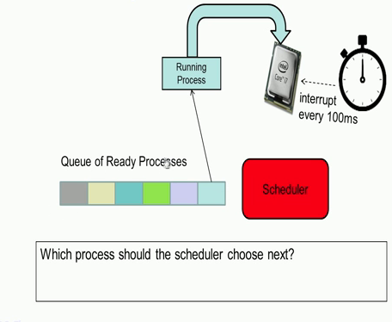
Which Process to choose?

Slide 4
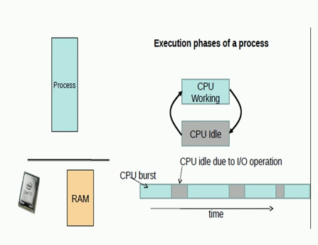
CPU Burst and IO Burst
When process is actually executing instructions it is known as a CPU burst
When process is blocked on an I/O not doing any operations, the CPU is idle, it is known as IO Burst

Slide 5
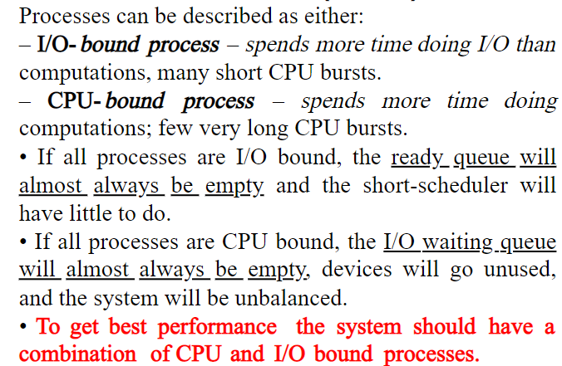
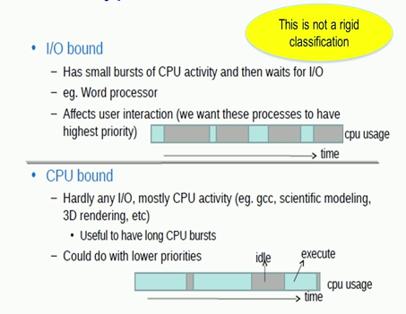
CPU bound and I/O bound process

Slide 6
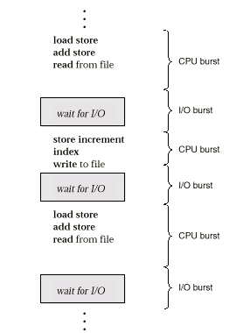
Alternating Sequence of CPU And I/O Bursts
A process which behaves both like an I/O bound as well as CPU bound, you could take for instance Microsoft excel. When we are actually entering data into the various cells in excel, it acts as I/O bound process. So, it behaves like an I/O bound process with small CPU burst and large times of I/O cycles.
While on the other hand when you are actually computing some statistic on the data entered, Excel will behave like a CPU bound process, where there is a large portion of CPU activity or the time taken to actually operate on that particular data.

Slide 7
Alternating Sequence of CPU And I/O Bursts
CPU bound processes could work with a lower priority
CPU bound applications like ‘gcc’ that is compiling a large program which takes 5 minutes. Now it will not effect this user much if the time taken to compile that particular program increases from 5 minutes to say 5.5 minutes.
I/O bound process such as the word processor higher priority with which it will get the CPU, so that the user interaction with the CPU becomes more comfortable

Slide 8
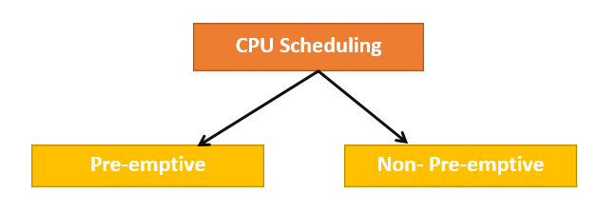
Types of CPU Scheduling
Here are two kinds of Scheduling methods:
Preemptive Scheduling
In Preemptive Scheduling, the tasks are mostly assigned with their priorities. Sometimes it is important to run a task with a higher priority before another lower priority task, even if the lower priority task is still running. The lower priority task holds for some time and resumes when the higher priority task finishes its execution.
2. Non-Preemptive Scheduling
In this type of scheduling method, the CPU has been allocated to a specific process. The process that keeps the CPU busy will release the CPU either by switching context or terminating. It is the only method that can be used for various hardware platforms. That’s because it doesn’t need special hardware (for example, a timer) like preemptive scheduling.

Slide 9
Scheduling Criteria
CPU utilization – keep the CPU as busy as possible
Throughput – # of processes that complete their execution per time unit
Turnaround time – amount of time to execute a particular process
Waiting time – amount of time a process has been waiting in the ready queue
Response time – amount of time it takes from when a request was submitted until the first response is produced, not output (for time-sharing environment)

Slide 10
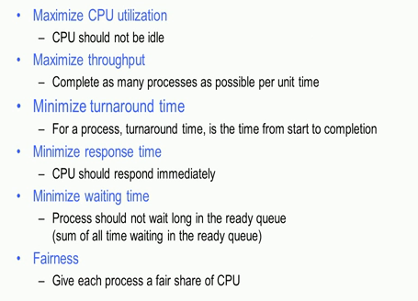
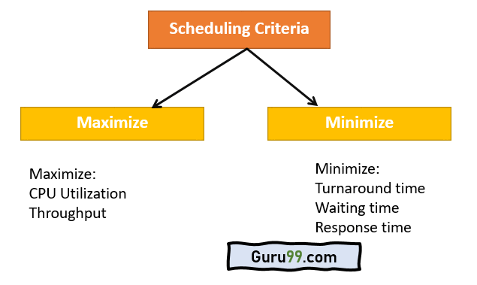
Optimization Criteria

Slide 11
Scheduling Algorithms
CPU scheduling deals with the problem of choosing a process from the ready queue to be executed by the CPU.
The following CPU scheduling algorithms will be described:
First-Come, First-Served (FCFS).
Shortest-Job-First (SJF).
Priority.
Round-Robin (RR).
Multilevel Queue.
Multilevel Feedback Queue.

Slide 12
Formula for Non-preemptive scheduling
startTime = Time at which the process started executing
completionTime (CT)= Time at which the process finished executing
Burst time (BT): The time required by a process for its execution is called as burst time.
arrivalTime(AT): Time at which the process enters Ready queue
WaitingTime(WT) = Waiting time for a process is the time duration which is spent in waiting queue by that process. (TAT – BT)
TurnaroundTime(TAT) = The time difference between completion time and arrival time is called as turnaround time. (CT - AT)
Response Time(RT)= The first scheduled time for a process is called response time. firstResponse - arrival Time (AT)

Slide 13
First-Come, First-Served (FCFS) Scheduling
First come first serve (FCFS) scheduling algorithm simply schedules the jobs according to their arrival time.
The job which comes first in the ready queue will get the CPU first. The lesser the arrival time of the job, the sooner will the job get the CPU.
FCFS scheduling may cause the problem of starvation if the burst time of the first process is the longest among all the
Completion
3
2
1
CPU
Ready Queue

Slide 14
First-Come, First-Served (FCFS) Scheduling
Example: Process Burst Time (milliseconds)
P₁ 24
P₂ 3
P₃ 3
Suppose that the processes arrive in the order: P₁ , P₂ , P₃ The Gantt Chart for the schedule is:
Waiting time for P₁ = 0; P₂ = 24; P₃ = 27
Average waiting time: (0 + 24 + 27) / 3 = 17 (milliseconds)
P₁
P₂
P₃
0
24
27
30

Slide 15
FCFS Scheduling (Cont.)
Suppose that the processes arrive in the order
P₂ , P₃ , P₁ .
The Gantt chart for the schedule is:
Waiting time for P₁ = 6; P₂ = 0; P₃ = 3
Average waiting time: (6 + 0 + 3) / 3 = 3 (milliseconds)
Much better than previous case.
The order of processes in FCFS queue is important.
P₂
P₃
P₁
0
3
6
30

Slide 16
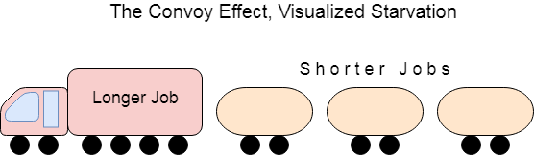
Convoy Effect in FCFS
FCFS may suffer from the convoy effect if the burst time of the first job is the highest among all. As in the real life, if a convoy is passing through the road then the other persons may get blocked until it passes completely. This can be simulated in the Operating System also.
If the CPU gets the processes of the higher burst time at the front end of the ready queue then the processes of lower burst time may get blocked which means they may never get the CPU if the job in the execution has a very high burst time. This is called convoy effect or starvation.

Slide 17
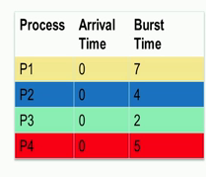
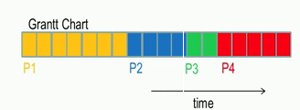
FCFS Example
Average waiting time: (0+7+11+13)/4= 7.75
Average response time: (0+7+11+13)/4= 7.75

Slide 18
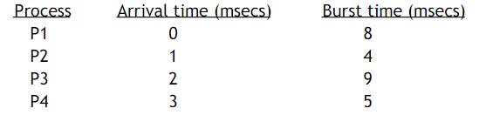
FCFS problem
Given below are the arrival and burst times of four processes P1, P2, P3 and P4. Draw the Gantt Chart using FCFS. Calculate the average waiting time, average turn around time and average response time.

Slide 19
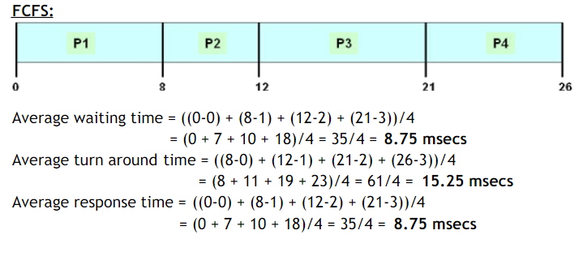
Solution

Slide 20
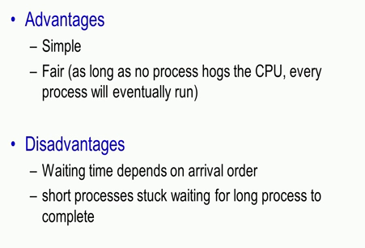
FCFS pros and Cons

Slide 21
THANK YOU

